Slide 1

INTRO TO
PYTHON

Slide 2
Topics
/01
/02
/Why Python?
/Programming Concepts
What is programming?
Basics of python.
why is it so popular?
What’s Python used for?
/03
/04
/Programming Environment
/Reading Materials
VS Code vs Python Terminal
References for further reading

Slide 3
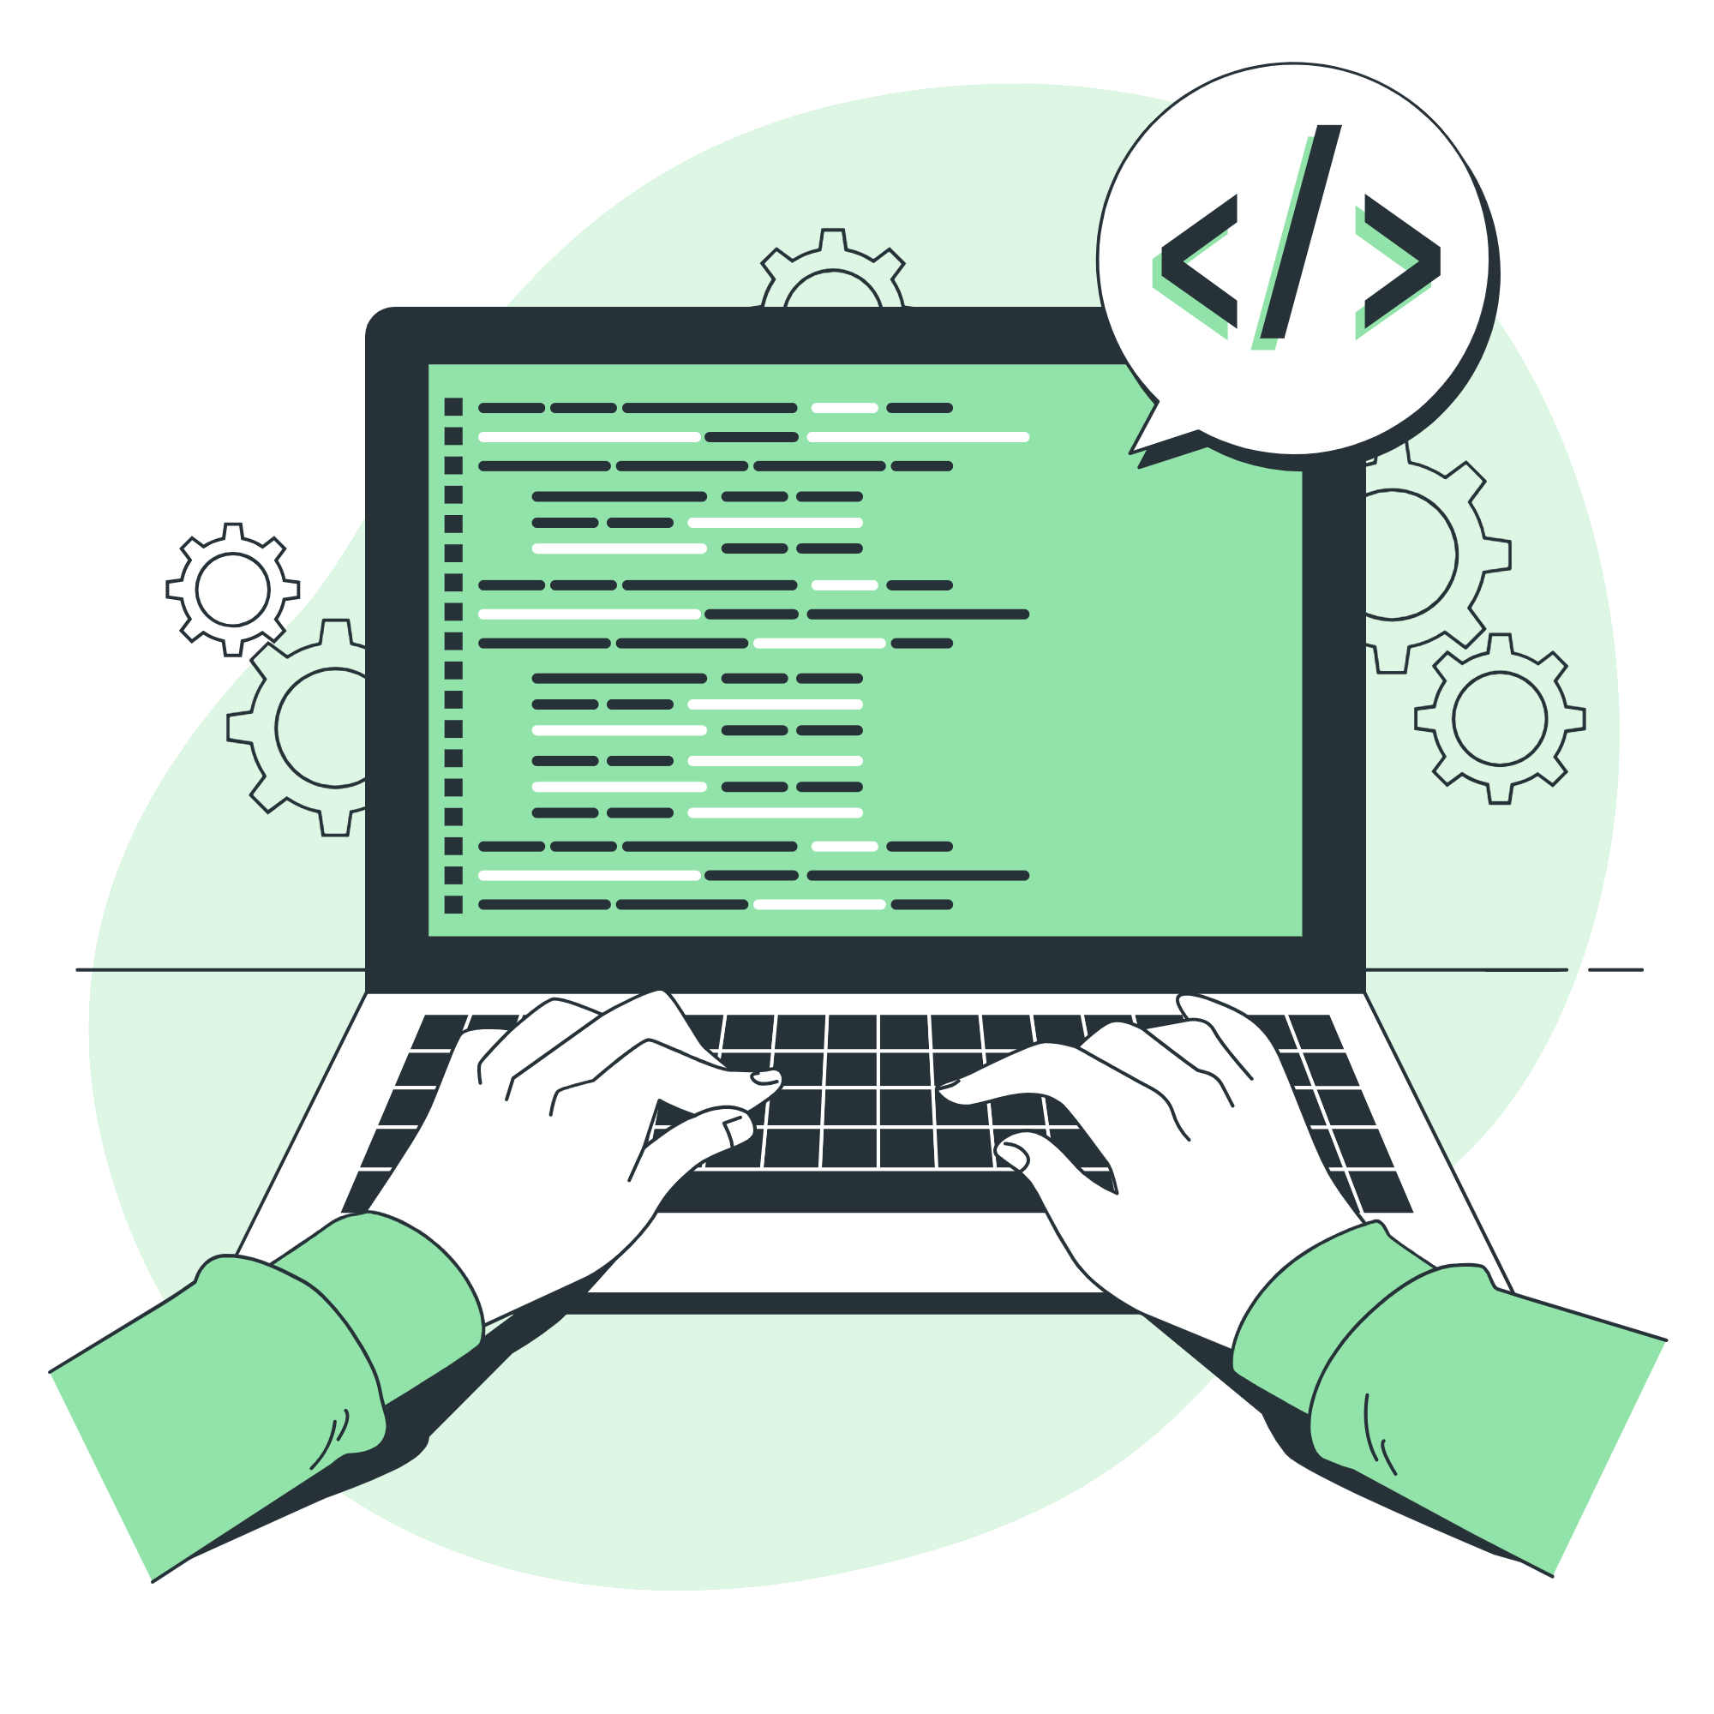
What is programming?
In simple terms, programming is giving a set of instructions to a computer to execute.

Slide 4
Basics of Python.
GENERAL PURPOSE
INTERPRETED
DYNAMICALLY-TYPED
It can be used to create a variety of different programs and isn’t specialized for any specific problems
Interpreted languages have Interpreters that run through a program line by line and execute each command.
Python dynamically finds out the type of our variables

Slide 5
What is programming?
In simple terms, programming is giving a set of instructions to a computer to execute.

Slide 6
why is it so popular?
/WEB AND SOFTWARE
/ML & AI
/AUTOMATION
/DATA ANALYSIS
Python is often used to develop the back end of a website or application
Python is used for Machine Learning (ML) and Artificial Intelligence (AI) projects
You can write Python code to automate task
Python can be used to analyse and visualize data

Slide 7
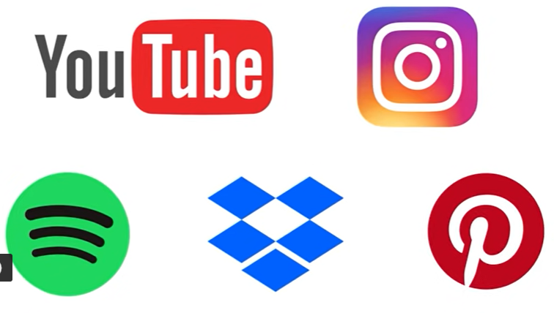
What’s Python used for?
In space: NASA
  uses Python for its central command system.
music and Social Media platforms
YouTube, Instagram, Spotify…etc.

Slide 8
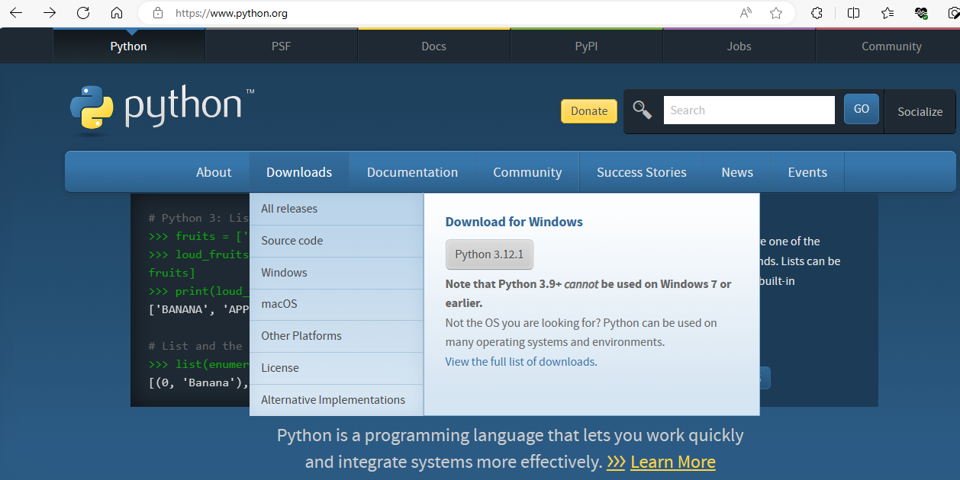
Python Installation.

Slide 9
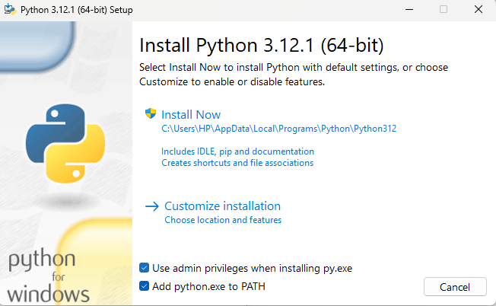
Python Installation(windows). Cont.…

Slide 10
What’s IDE
IDE stands for Integrated Development Environment. It's a software application that provides a comprehensive set of tools and features to facilitate software development.
An IDE typically combines a source code editor, a compiler or interpreter, build automation tools, debugging tools, and other utilities into a single integrated interface.

Slide 11
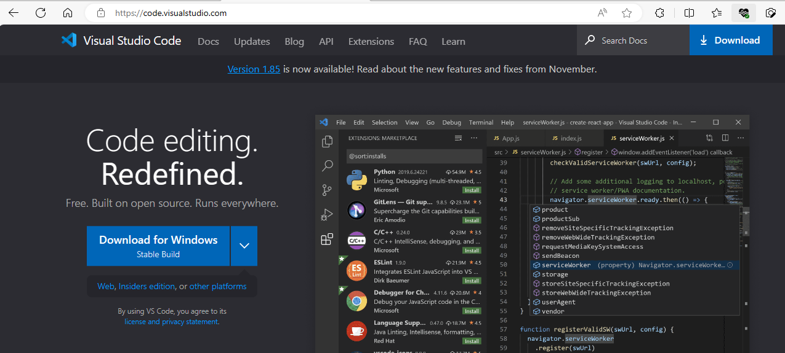
Vs Code Installation.

Slide 12
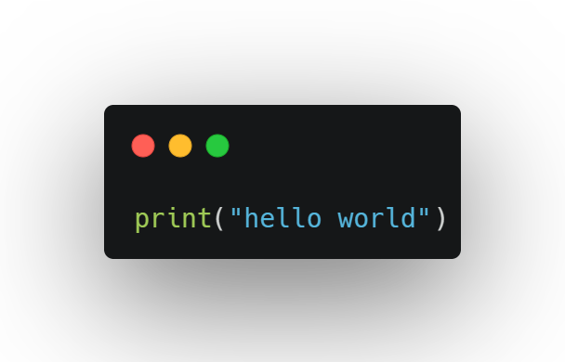
Print statement
*Does exactly what it sounds like
print “hello world”

Slide 13

Comments in python
Comments are some piece of English text which explains what the code does
we write comments in the code so that is easier for others to understand.
# is used to indicate comment

Slide 14
Python Variables
Variables are memory locations that store some data.
Used to store a value, whether it be a number, text, or a Boolean (true/false) value.
Later in your code, you can simply use the variable that holds that value.
Python is case-sensitive.
Choosing Good Identifiers
A-Z, a-z, 0-9 , _
Keywords can not be variables(Identifiers)

Slide 15
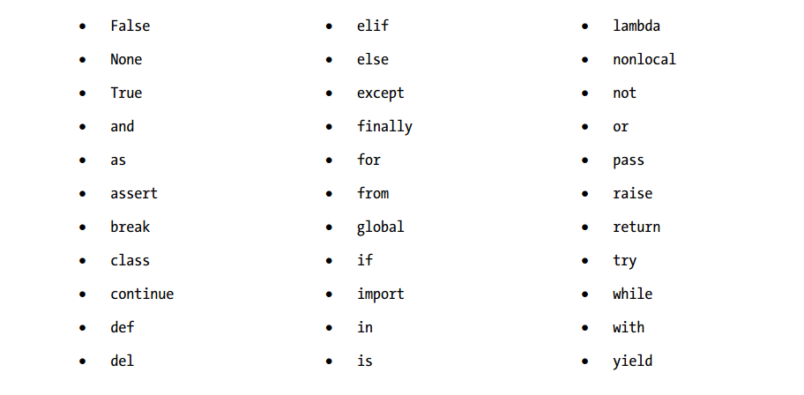
Python Keywords

Slide 16
Python Variables
Unlike Java, C++ and C#, Python is not a strongly typed language.
In java or c++ int VariableName = 3
In python VariableName=3

Slide 17
Activity 1
Which variables are valid and which ones are not.(state your reason)
a. myvar = "John"
b. my_var = "John"
c. _my_var = "John"
d. myVar = "John"
e. MYVAR = "John"
f. myvar2 = "John"
g. 2myvar = "John"
h. my var = "John"
i. my-var = "John“
j. if = “John”

Slide 18
Basic math Operations in Python.
+ - * /
// used to display round up results
% used to get the remainder
** used for the “power of”

Slide 19
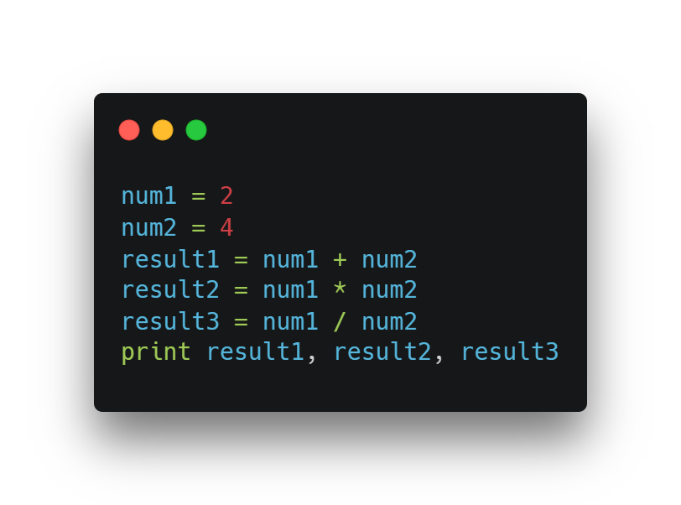
Assigning Variables

Slide 20
Activity 2
Question one.
write a code that divides 18 by 4 and display the result
Question two:
Write a code that shows result of 5
Question three:
write a code to get the remainder of 18 divided by 4?
2

Slide 21
Python Data Types
/Integers -int
/Float-float
/Strings-str
a collection of 1 or more characters put in a single quote, double-quote or triple quote
contains positive or negative whole numbers (without fraction or decimal)
Is a real number with floating point representation.
/Booleans-bool
/Lists
/Set
Represents either True or False
store multiple items in a single variable
store multiple unique items in a single variable

Slide 22
Python Strings
In Python, a string is a sequence of characters enclosed within single quotes (') or double quotes ("). Strings are one of the fundamental data types in Python and are commonly used to represent text or a sequence of characters.
Strings in Python are immutable, which means they cannot be changed once created. Operations on strings, such as concatenation or slicing, result in the creation of a new string.

Slide 23
Strings concatenation
Example
fname = “Abebe”
lname = “Almaz”
print fname + lname == print “Abebe”+”Almaz”
print “Abebe”,”Almaz” = this gives space b/n them

Slide 24
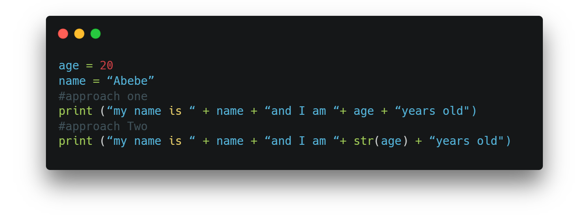
String example
Which approach do you think will work

Slide 25
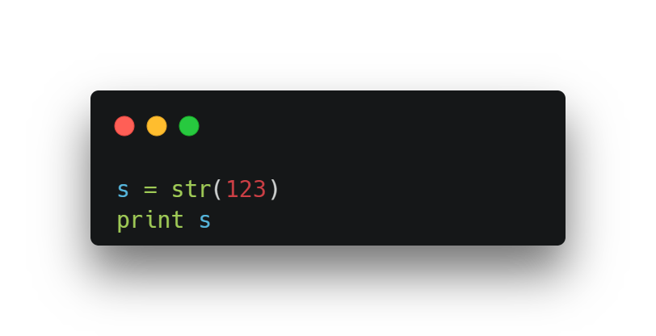
Converting
One Type into Another
To change string to integer we use int(value)
To change integer to string we use Str(value)

Slide 26
Activity 3
Write a program to display your information in one statement.
Name, age, hobby, favorite-animal
Sample output:
    My name is Abdi, I am 30 years old.and as a hobby I love reading books and my favorite animal is dog.

Slide 27
Deep dive into
Python String >>>

Slide 28
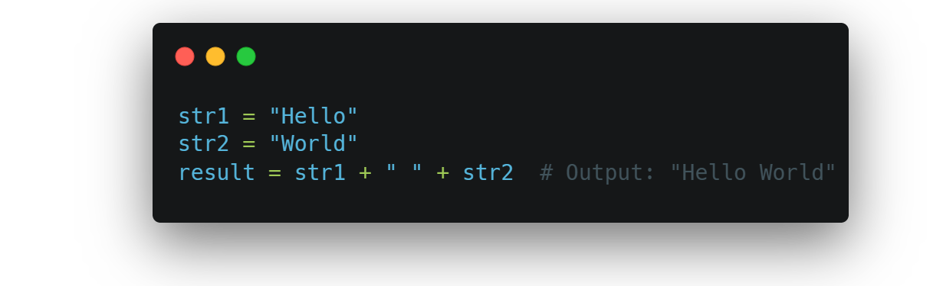
String Operations
Python provides a variety of string operations that allow you to manipulate and work with strings effectively. Here are some commonly used string operations in Python:
1, Concatenation: You can concatenate two or more strings using the + operator. For example:

Slide 29
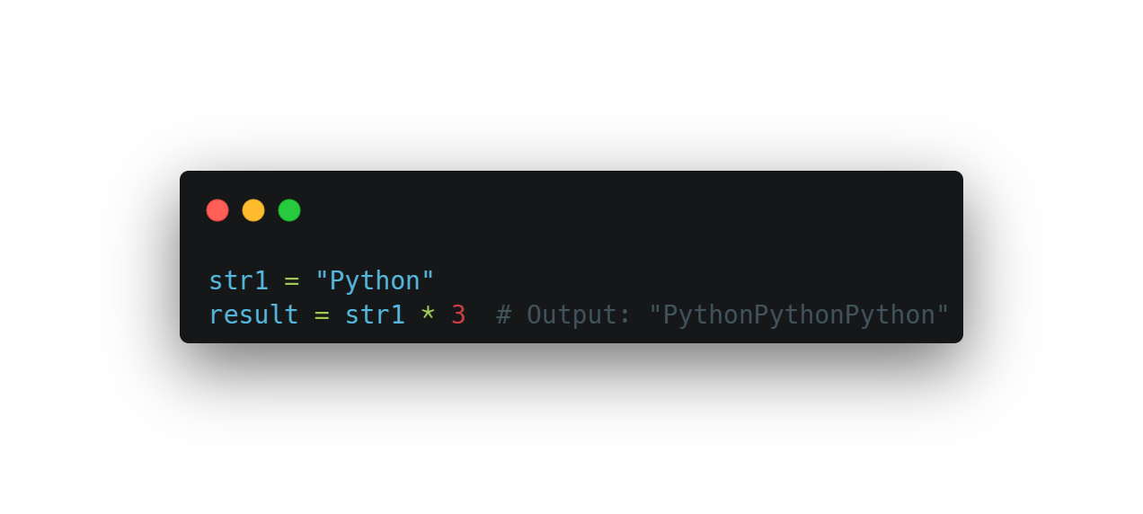
String Operations cont.…
2, Repetition: You can repeat a string multiple times using the * operator. For example:

Slide 30
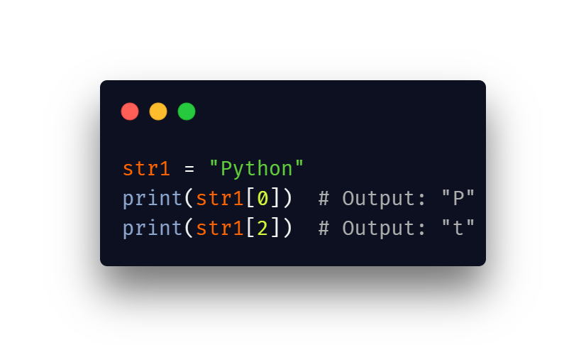
String Operations cont.…
3, Indexing: Strings are sequences of characters, and you can access individual characters by their index using square brackets []. Python uses 0-based indexing.

Slide 31
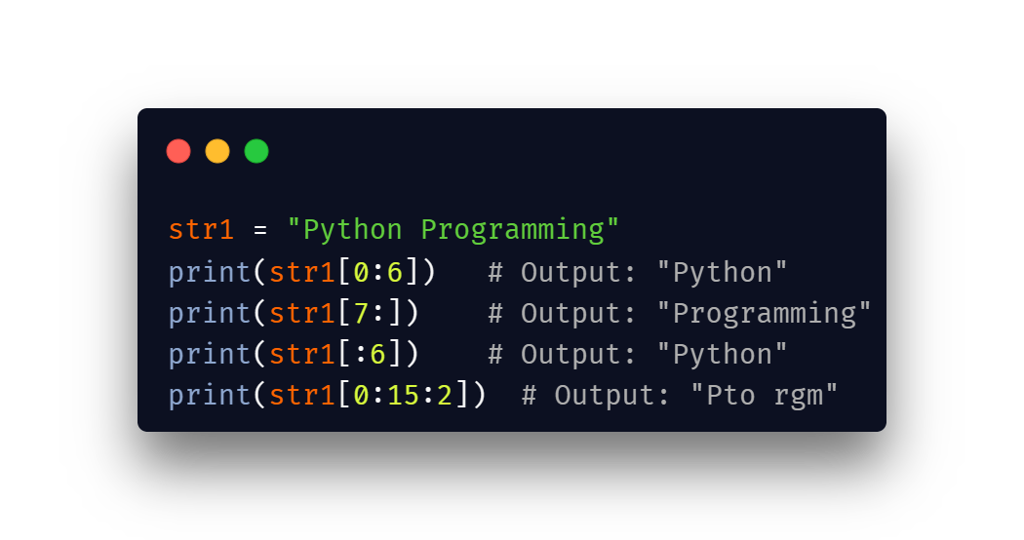
String Operations cont.…
4, Slicing: You can extract a substring from a string using slicing. It allows you to specify the start and end indices to create a new string that includes characters within that range. The slicing syntax is start:end:step.

Slide 32
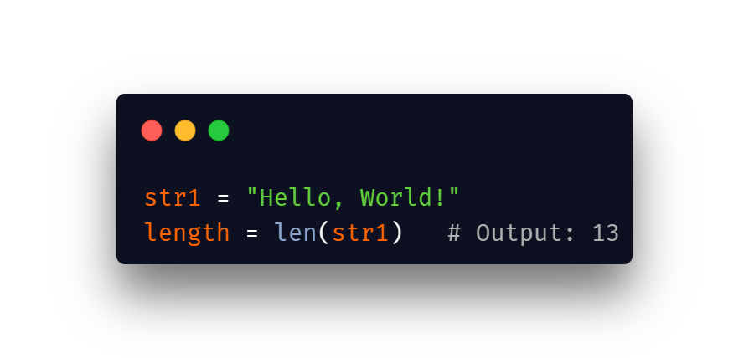
String Operations cont.…
5, Length: You can determine the length of a string using the len() function. It returns the number of characters in the string. For example:

Slide 33
String Operations cont.…
5, String Methods
Python provides a variety of built-in string methods that perform various operations on strings. Some commonly used methods include:
  lower(): Converts the string to lowercase.
  upper(): Converts the string to uppercase.
  split(): Splits the string into a list of substrings based on a specified separator.
  strip(): Removes leading and trailing whitespace from the string.

Slide 34
Assignment
Write a Python program that accomplishes the following tasks for a given sentence:
Concatenate the first three characters of the sentence with the last three characters of the sentence.
Convert the concatenated string to uppercase.
Repeat the uppercase string two times.
Extract the substring from the 5th to the 10th character (inclusive) from the repeated string.
Convert each word to lowercase.
Print the modified list of lowercase words along with its length.

